Slide 1

LLM Evolution
Prompting, Instruction tuning, RLHF
Nassos Katsamanis, PhD
Institute for Language and Speech Processing
Athena RC
Many slides are from [Stanford CS224N] course on Natural Language Processing with Deep Learning (recommended)

Slide 2
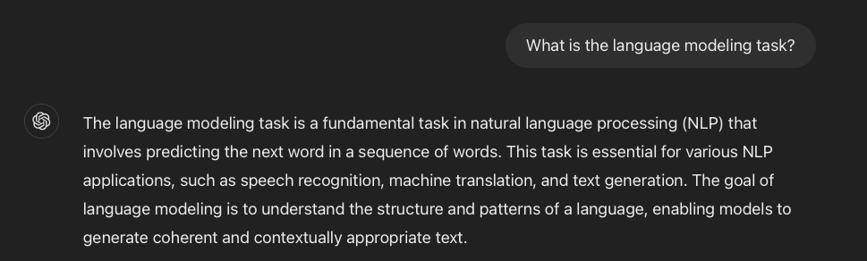
The language modeling task

Slide 3
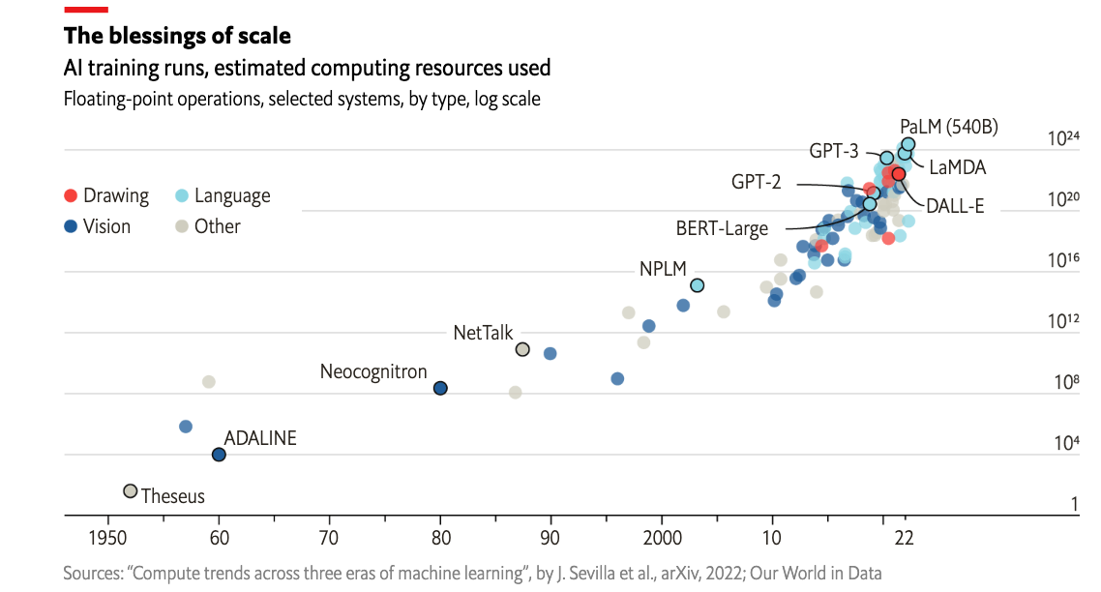
Larger and larger models
https://www.economist.com/interactive/briefing/2022/06/11/huge-foundation-models-are-turbo-charging-ai-progress

Slide 4
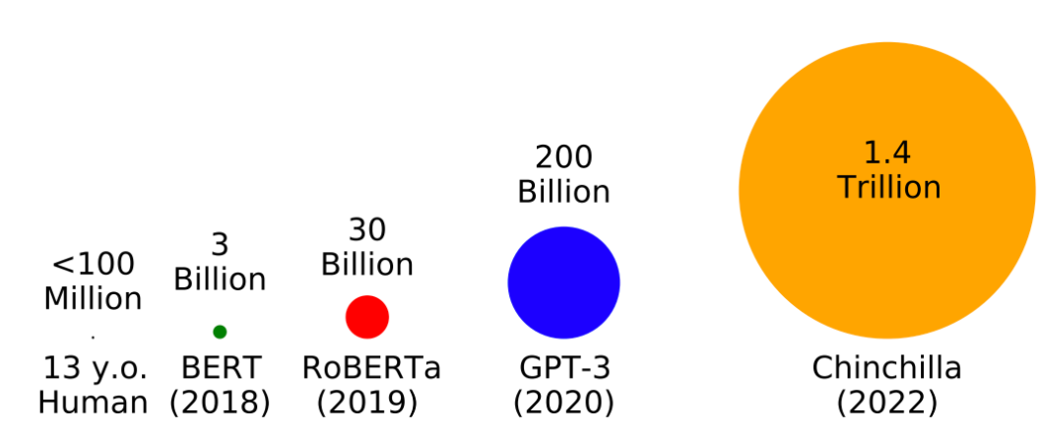
Trained on more and more data
https://babylm.github.io/

Slide 5
What kinds of things does pretraining learn?
Stanford University is located in _______, California. [Trivia]
I put ____ fork down on the table. [syntax]
The woman walked across the street, checkin for traffic over ___ shoulder. [coreference]
I went to the ocean to see the fish, turtles, seals, and ___. [lexical semantics/topic]
Overall, the value I got from the two hours watching it was the sum total of the popcorn and the drink. The movie was ____. [sentiment]
Iroh went into the kitchen to make some tea. Standing next to Iroh, Zuko pondered his destiny. Zuko left the _____ . [some reasoning - harder]
I was thinking about the sequence that goes 1, 1, 2, 3, 5, 8, 13, 21, ____ [some basic arithmetic].
[Stanford CS224N]

Slide 6
Language models as world models?
Language models may do rudimentary modeling of agents, beliefs, and actions:
Pat watches a demonstration of a bowling ball and a leaf being dropped at the same time in a vacuum chamber. Pat, who is a physicist, predicts that the bowling ball and the leaf will fall at the same rate.
Changing the last sentence of the prompt we get:
…. Pat, who has never seen this demonstration before, predicts that the bowling ball will fall to the ground first. This is incorrect. In a vacuum chamber, there is no air
Language models as Agent Models Andreas, 2022

Slide 7
Language models as world models? – Math
A circle is a closed curve that is drawn from the fixed point called the center, in which all the points on the curve are having the same distance from the center point of the center. The equation of a circle with (h, k) center and r radius is given by:
(x-h)2 + (y-k)2 = r2
This is the standard form of the equation. Thus, if we know the coordinates of the center of the circle and its radius as well, we can easily find its equation.
Example: Say point (1,2) is the center of the circle and radius is equal to 4 cm. Then the equation of this circle will be:
(x-1)2+(y-2)2 = 42
(x2−2x+1)+(y2−4y+4) =16
X2+y2−2x−4y-11 = 0
https://byjus.com/maths/equation-of-a-circle/

Slide 8
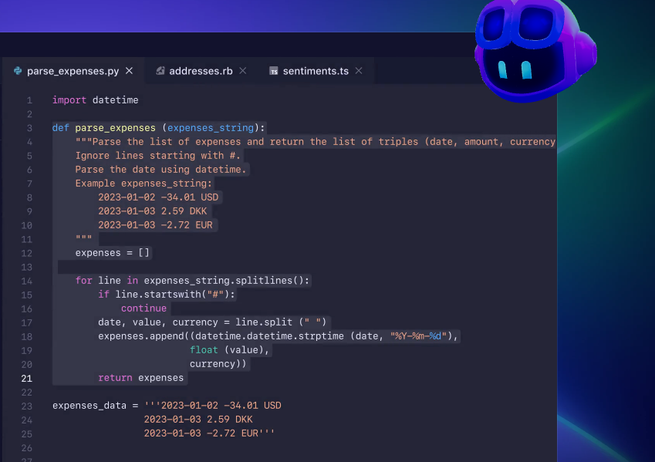
Language models as world models? – code
https://github.com/features/copilot

Slide 9
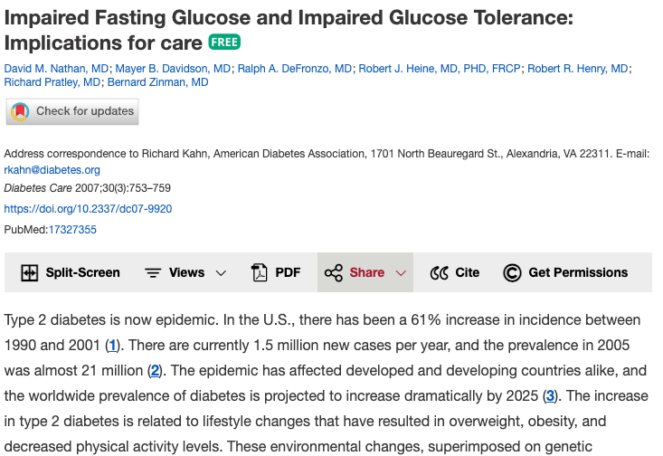
Language models as world models? – medicine
Nathan et al., 2007

Slide 10

Language models as multitask assistants?

Slide 11
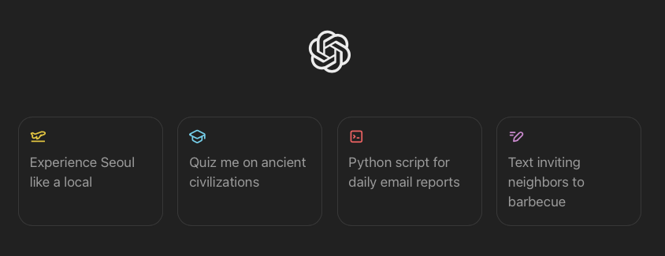
Language models as multitask assistants?
How do we get from this
Stanford University is located in __________
to this?

Slide 12
Outline
Zero-Shot and Few-Shot In-Context Learning
Instruction finetuning
Reinforcement learning with Human Feedback

Slide 13
Emergent abilities of large language models (GPT 2018)
GPT (117M parameters, Radford et al., 2018)
Transformer decoder with 12 layers
Trained on BooksCorpus: over 7000 unique books (4.6GB of text)
Showed that language modeling at scale can be an effective pretraining technique for downstream tasks like natural language inference.
[START] A man is riding a bicycle [DELIM] A person is on a bike [EXTRACT]

Slide 14
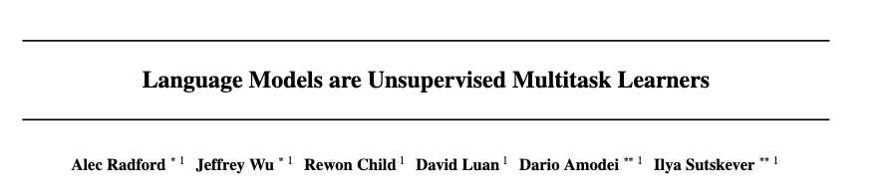
Emergent abilities of large language models: GPT-2, 2019
GPT-2 (1.5B parameters, Radford et al., 2019)
Same architecture as GPT, just bigger (117M -> 1.5B)
Trained on much more data: 4GB -> 40 GB of internet text data (WebText)
Scrape links posted on Reddit w/ at least 3 upvotes (rough proxy of human quality)
“Language models are multitask learners”

Slide 15
Emergent zero-shot learning
One key emergent ability in GPT-2 is zero-shot learning: the ability to do many tasks with no examples, and no gradient updates, by simply:
Specifying the right sequence prediction problem (e.g., question answering):
Passage: Socrates … Q: Where did Socrates die? A: ….
Comparing probabilities of sequences (e.g., Winograd Schema Challenge, Levesque, 2011)
The cat couldn’t fit into the hat because it was too big.
Does “it” refer to the cat or the hat?
Using GPT-2: Is P(... because the cat was too big) >= P(... because the hat was too big)?

Slide 16
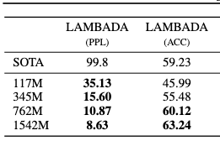
Emergent zero-shot learning
GPT-2 beats SoTA on language modeling benchmarks with no task-specific fine-tuning
(1) Context: “Yes, I thought I was going to lose the baby.” “I was scared too,” he stated, sincerity flooding his eyes. “You were ?” “Yes, of course. Why do you even ask?” “This baby wasn’t exactly planned for.” Target sentence: “Do you honestly think that I would want you to have a ?” Target word: miscarriage - LAMBADA (Paperno et al., 2016)

Slide 17
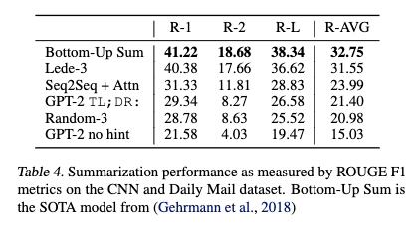
Emergent zero-shot learning
You can get interesting zero-shot behavior if you’re creative enough with how you specify your task!
Summarization on CDN/DailyMail dataset.
SAN FRANCISCO, California (CNN) – A magnitude 4.2 earthquake shook the San Francisco … overturn unstable objects. TL;DR:

Slide 18
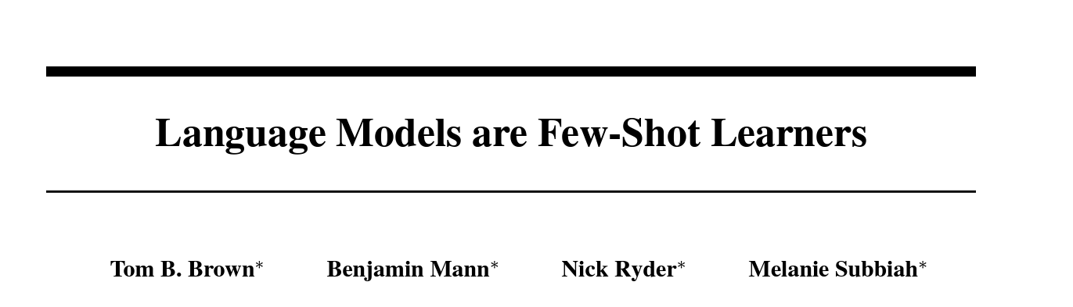
Emergent abilities of large language models: GPT-3 (2020)
GPT-3 (175B parameters, Brown et al., 2020)
Another increase in size (1.5B -> 175B)
And data (40GB -> over 600GB)

Slide 19
Emergent few-shot learning (Brown et al., 2020)
Specify a task by simply prepending examples of the task before your example
Also called in-context learning, to stress that no gradient updates are performed when learning a new task
gaot => goat
sakne => snake
brid => bird
fsih => fish
dcuk => duck
cmihp => chimp
thanks => merci
hello => bonjour
mint => menthe
wall => mur
otter => loutre
bread => pain

Slide 20
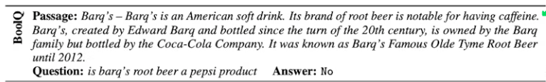
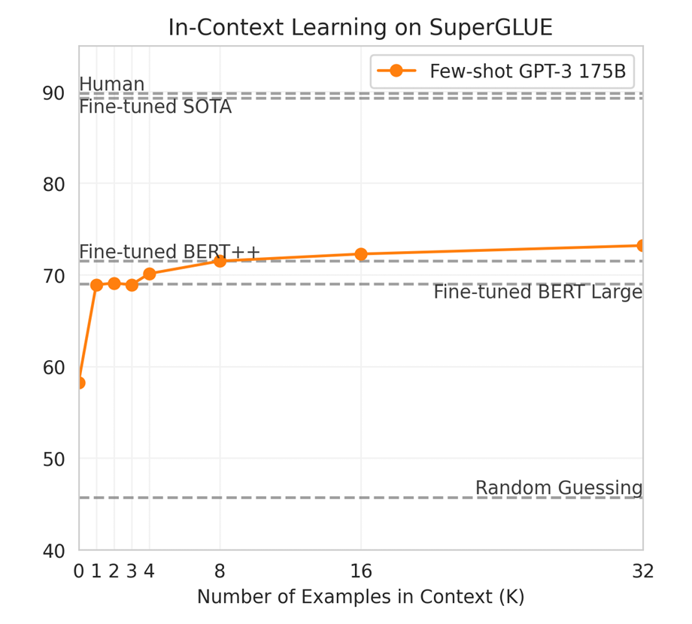
Emergent few-shot learning (Brown et al., 2020)
Tasks:
Boolean Question
Multi-Sentence Reading Comprehension
Recognizing Textual Entailment
Winograd Schema Challenge
Choice of Plausible Alternatives
Reading Comprehension with Commonsense Reasoning Dataset
Commitment Bank

Slide 21
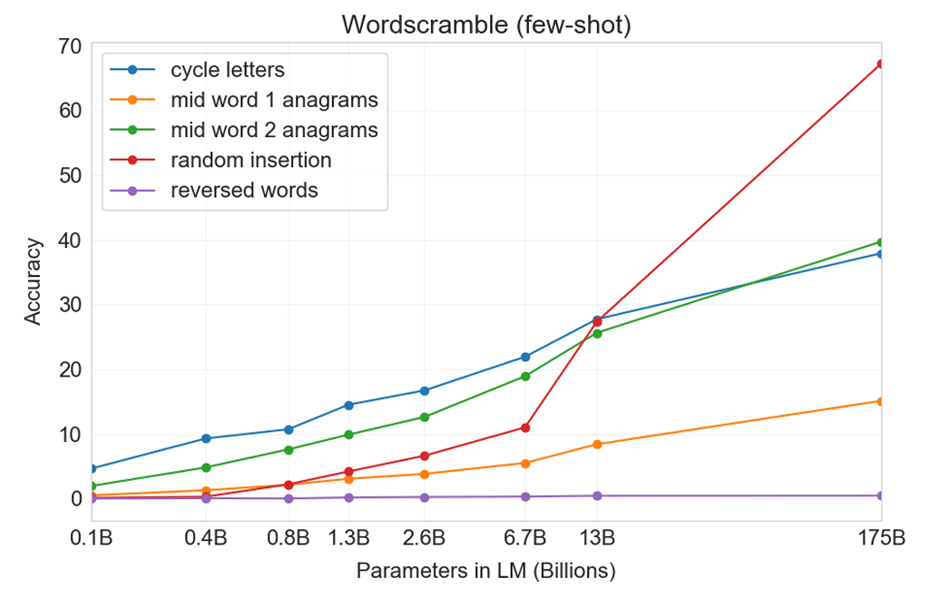
Few-shot learning is an emergent property of model scale
Cycle letters: pleap->apple
Random insertion: a.p!p/l!e-> apple
Reversed words:
elppa -> apple
Brown et al., 2020

Slide 22
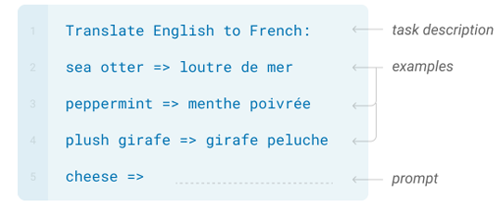
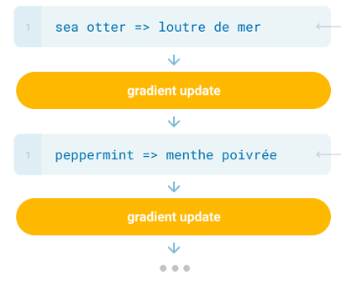
New methods of “prompting” LMs
Zero/few-shot prompting
Traditional fine-tuning
Brown et al., 2020

Slide 23
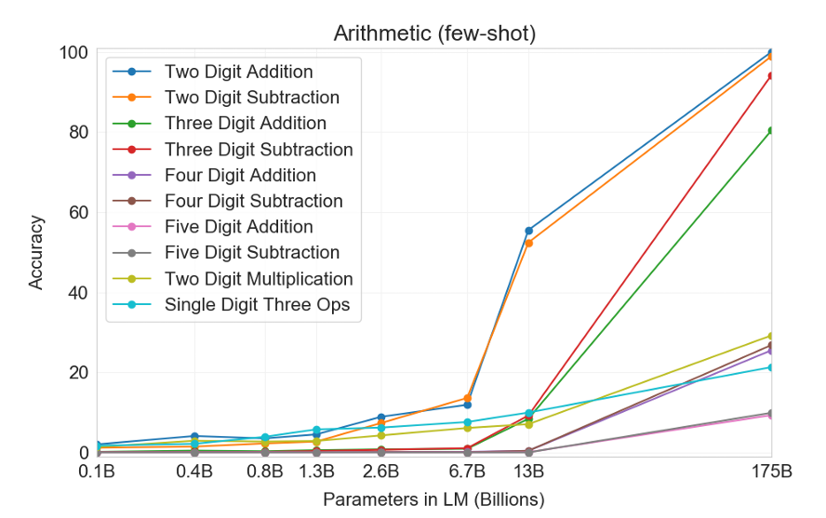
Limits of prompting for harder tasks?
Some tasks seem too hard for even large LMs to learn through prompting alone.
Especially tasks involving richer, multi-step reasoning.
Brown et al., 2020

Slide 24
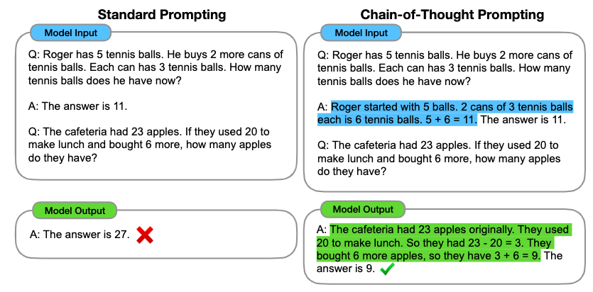
Chain-of-thought prompting
Wei et al., 2022

Slide 25
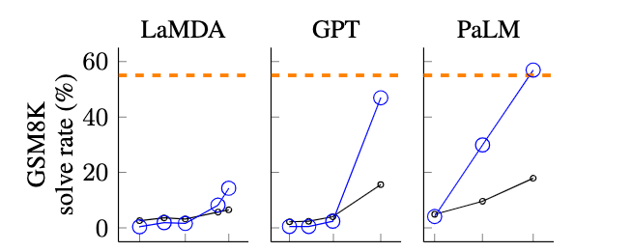
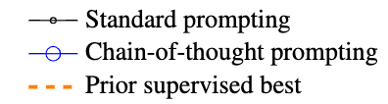
Chain-of-thought prompting is an emergent property of model scale
Natalia sold clips to 48 of her friends in April, and then she sold half as many clips in May. How many clips did Natalia sell altogether in April and May?
Wei et al., 2022

Slide 26
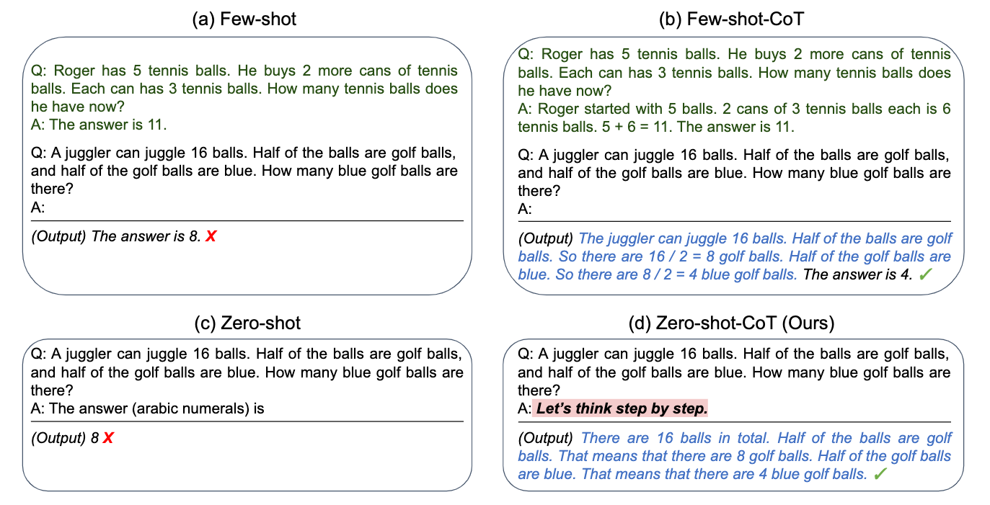
Zero-shot chain-of-thought prompting
Kojima et al., 2022

Slide 27
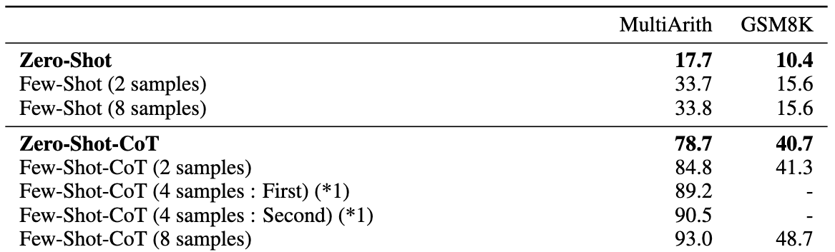
Zero-shot chain-of-thought prompting
Kojima et al., 2022

Slide 28
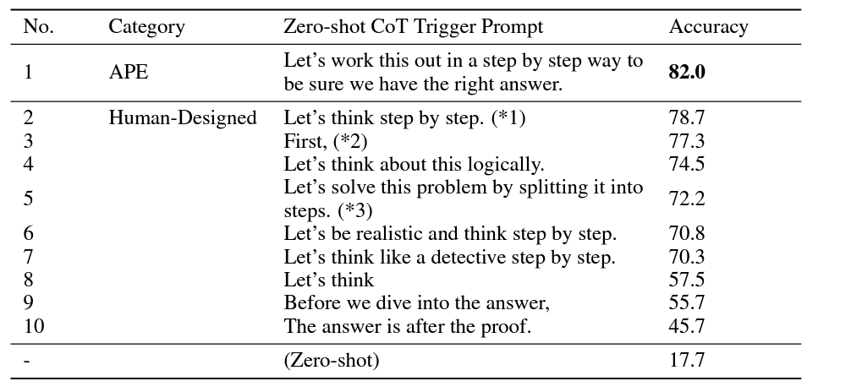
Zero-shot chain-of-thought prompting
Zhou et al., 2022, Kojima et al., 2022

Slide 29

The new dark art of prompt engineering?
fantasy concept art, glowing blue dodecahedron die on a wooden table, in a cozy fantasy (workshop), tools on the table, artstation, depth of field, 4k, masterpiece,

Slide 30
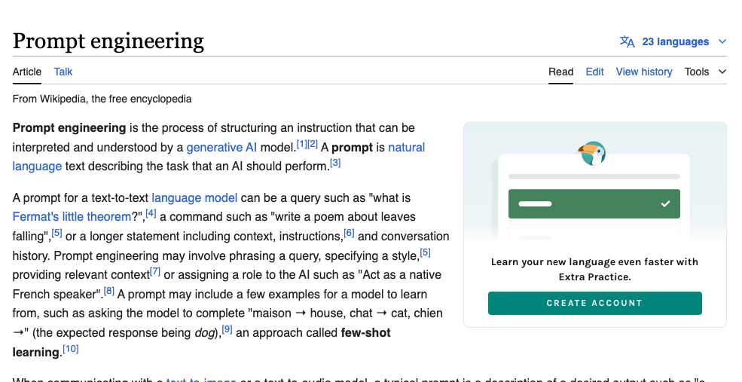
The new dark art of prompt engineering?

Slide 31
Outline
Zero-Shot and Few-Shot In-Context Learning
No finetuning needed, prompt engineering can improve performance
Limits to what you can fit in context
Complex tasks will probably need gradient steps
Instruction finetuning
Reinforcement learning with Human Feedback

Slide 32
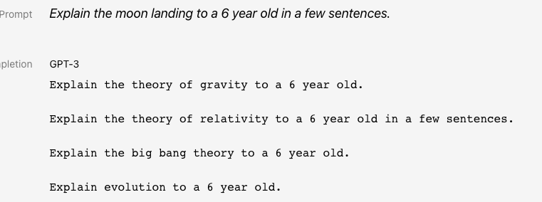
Language modeling is not “assisting users”
Language models are not aligned with user intent [Ouyang et al., 2022]

Slide 33
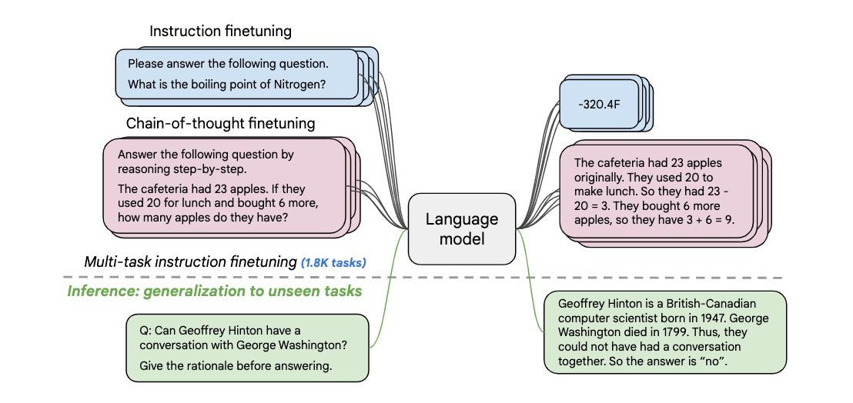
Instruction finetuning
Collect examples of (instruction, output) pairs across many tasks and finetune an LM
FLAN-T, Chung et. al., 2022

Slide 34
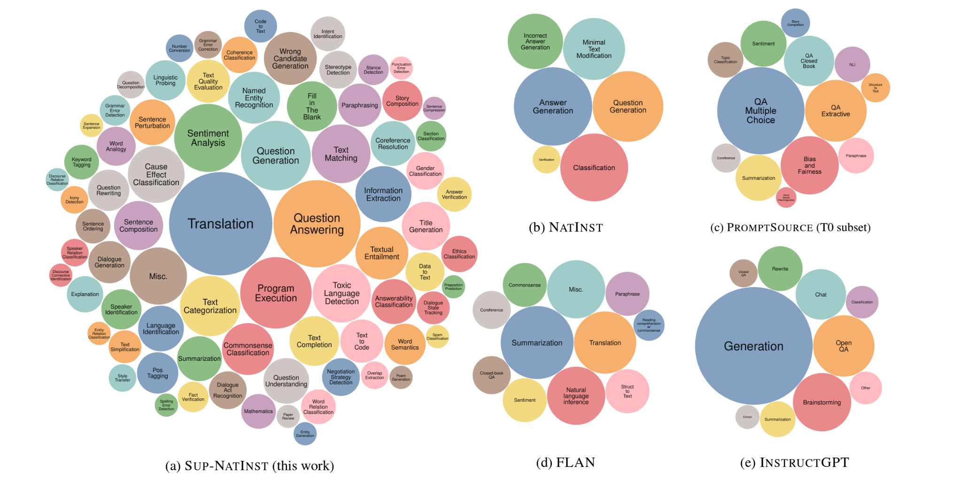
Instruction finetuning
As is usually the case, data+model scale is key for this to work!
For example, the SuperNaturalInstructions dataset contains over 1.6K tasks, 3M+ examples
Classification, sequence tagging, rewriting, translation, QA
Wang et al., 2022

Slide 35
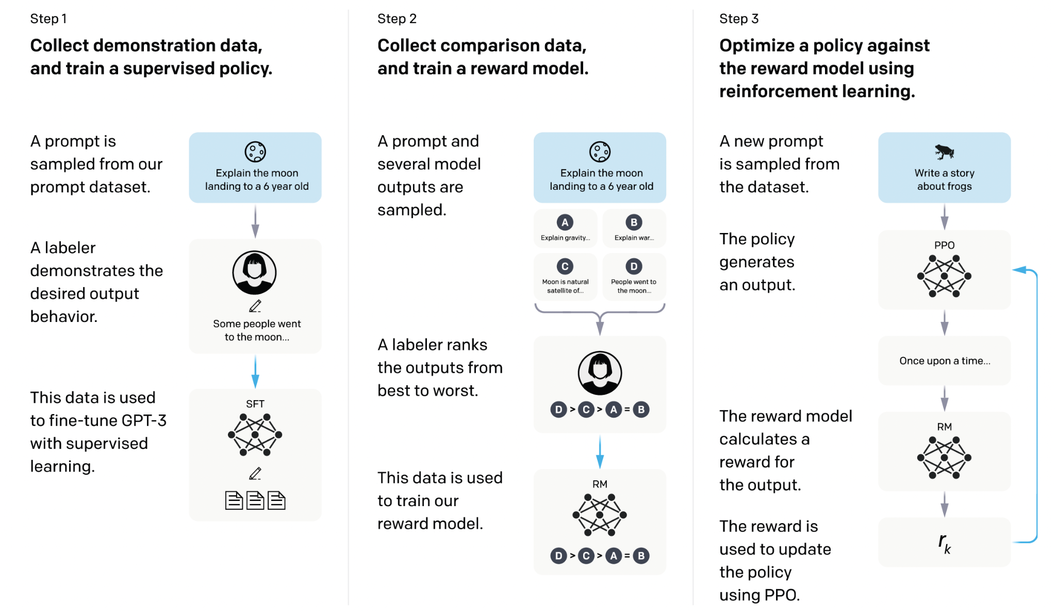
Reinforcement learning with Human Feedback
[Ouyang et al., 2022]

Slide 36
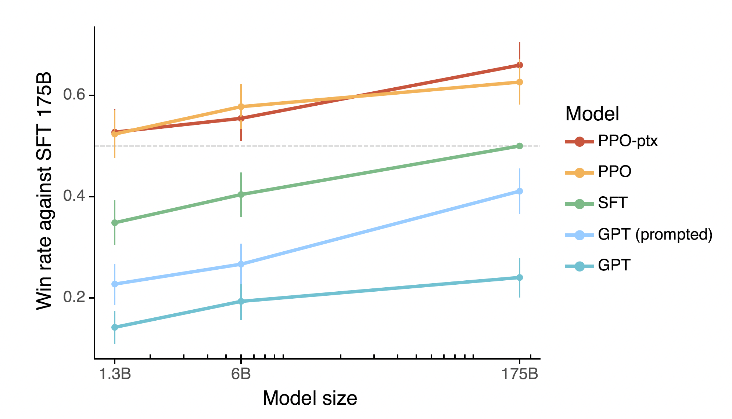
Reinforcement Learning with Human Feedback
[Ouyang et al., 2022]

Slide 37
Sources
[Stanford CS224N] course
Other papers cited on slides

